Slide 1

Chapter 11 – Thread && Input/Output && Exception Handling
Big Java by Cay Horstmann
Copyright © 2009 by John Wiley & Sons. All rights reserved.

Slide 2
Chapter Goals
Introduction to Threads
To be able to read and write text files
To learn how to throw exceptions
To be able to design your own exception classes
To understand the difference between checked and unchecked exceptions
To know when and where to catch an exception
Big Java by Cay Horstmann
Copyright © 2009 by John Wiley & Sons. All rights reserved.

Slide 3
Thread
What is a Thread?
  A sequence of execution within a process
  A separate process that can perform a computational task independently and concurrently with other threads
  A program can have Multiple threads
  A Lightweight process
Big Java by Cay Horstmann
Copyright © 2009 by John Wiley & Sons. All rights reserved.

Slide 4
Threads in Java
Threads can be created by extends class Thread
JVM allows multiple threads
Threads have a priority
  Higher priority threads are executed preferentially
  A newly created Thread has initial priority equal to the Thread that created it
Big Java by Cay Horstmann
Copyright © 2009 by John Wiley & Sons. All rights reserved.

Slide 5
Thread LifeCycle
There are several states for Thread
  Running
  Ready
  Waiting
  Dead
New
Ready
Running
Dead
Waiting
Big Java by Cay Horstmann
Copyright © 2009 by John Wiley & Sons. All rights reserved.

Slide 6
Current Thread
Thread.currentThread()
The static method Thread.currentThread() returns a pointer to the Thread object that represents the current running thread.
Example
int i = 6;
Thread me = Thread.currentThread();
Big Java by Cay Horstmann
Copyright © 2009 by John Wiley & Sons. All rights reserved.

Slide 7
Thread.sleep()
Thread.sleep(milliseconds) blocks the current thread for approximately the given number of milliseconds.
May throw an InterruptedException if the sleeping thread is interrupted.
Big Java by Cay Horstmann
Copyright © 2009 by John Wiley & Sons. All rights reserved.

Slide 8
Useful methods
getName()
getName() on a Thread object
By default, returns something like Thread-0, Thread-1, Thread-2, ... for each thread
Big Java by Cay Horstmann
Copyright © 2009 by John Wiley & Sons. All rights reserved.

Slide 9
Useful methods
Joining()
Suppose you want to wait for another worker thread to complete its run()
Send the join() message to the worker thread object -- worker.join() -- causes the current running thread to block efficiently until worker finishes its run
We must handle the InterruptedException that join() may throw. Java will break us out of the join if we are interrupted by another thread, so really there are two ways to get out of a join() -- the other thread finishes, or we are interrupted. In most cases, we will handle InterruptedException by doing nothing.
Big Java by Cay Horstmann
Copyright © 2009 by John Wiley & Sons. All rights reserved.

Slide 10
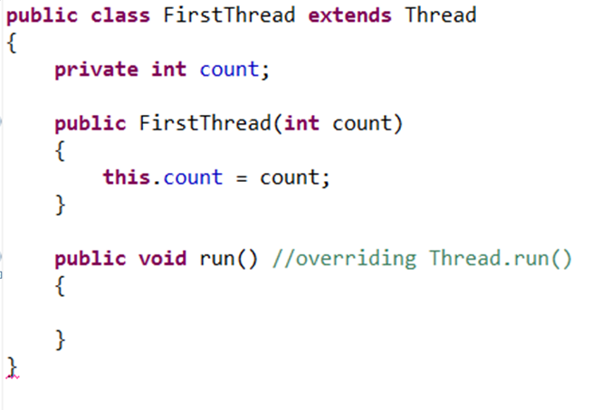
Creating Thread (1)
To run the Thread
FirstThread t1 = new FirstThread();
t1.start();
Big Java by Cay Horstmann
Copyright © 2009 by John Wiley & Sons. All rights reserved.

Slide 11
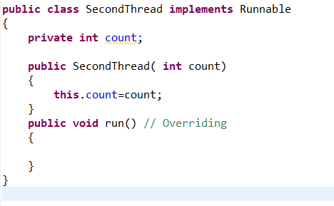
Creating Thread (2)
To run the Thread
SecondThread t1 = new SecondThread();
t2.start();
Big Java by Cay Horstmann
Copyright © 2009 by John Wiley & Sons. All rights reserved.

Slide 12
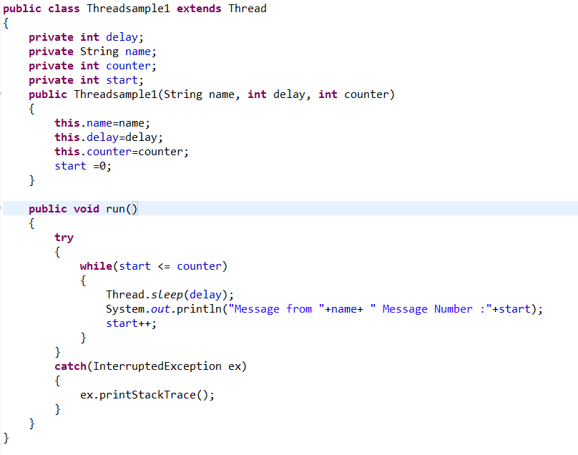
Example
Big Java by Cay Horstmann
Copyright © 2009 by John Wiley & Sons. All rights reserved.

Slide 13
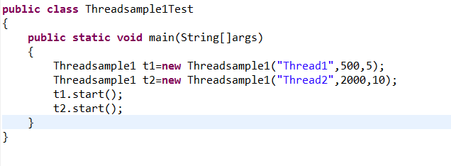
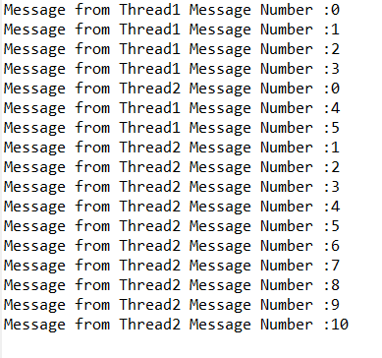
Example
Output :
Big Java by Cay Horstmann
Copyright © 2009 by John Wiley & Sons. All rights reserved.

Slide 14
Reading Text Files
Simplest way to read text: Use Scanner class
To read from a disk file, construct a FileReader
Then, use the FileReader to construct a Scanner object
FileReader reader = new FileReader("input.txt");
Scanner in = new Scanner(reader);
Use the Scanner methods to read data from file
  next, nextLine, nextInt, and nextDouble
Big Java by Cay Horstmann
Copyright © 2009 by John Wiley & Sons. All rights reserved.

Slide 15
Writing Text Files
To write to a file, construct a PrintWriter object:
  PrintWriter out = new PrintWriter("output.txt");
If file already exists, it is emptied before the new data are written into it
If file doesn’t exist, an empty file is created
Use print and println to write into a PrintWriter:
  out.println(29.95);
  out.println(new Rectangle(5, 10, 15, 25));
  out.println("Hello, World!");
You must close a file when you are done processing it:
  out.close();
Otherwise, not all of the output may be written to the disk file
Big Java by Cay Horstmann
Copyright © 2009 by John Wiley & Sons. All rights reserved.

Slide 16
FileNotFoundException
When the input or output file doesn’t exist, a FileNotFoundException can occur
To handle the exception, label the main method like this:
public static void main(String[] args) throws
FileNotFoundException
Big Java by Cay Horstmann
Copyright © 2009 by John Wiley & Sons. All rights reserved.

Slide 17
A Sample Program
Reads all lines of a file and sends them to the output file, preceded by line numbers
Sample input file:
  Mary had a little lamb
  Whose fleece was white as snow.
  And everywhere that Mary went,
  The lamb was sure to go!
Program produces the output file:
  /* 1 */ Mary had a little lamb
  /* 2 */ Whose fleece was white as snow.
  /* 3 */ And everywhere that Mary went,
  /* 4 */ The lamb was sure to go!
Program can be used for numbering Java source files
Big Java by Cay Horstmann
Copyright © 2009 by John Wiley & Sons. All rights reserved.

Slide 18
ch11/lines/LineNumberer.java
1 import java.io.File;
2 import java.io.FileNotFoundException;
3 import java.io.PrintWriter;
4 import java.util.Scanner;
5
6 /**
7 This program applies line numbers to a file.
8 */
9 public class LineNumberer
10 {
11 public static void main(String[] args) throws FileNotFoundException
12 {
13 // Prompt for the input and output file names
14
15 Scanner console = new Scanner(System.in);
16 System.out.print("Input file: ");
17 String inputFileName = console.next();
18 System.out.print("Output file: ");
19 String outputFileName = console.next();
20
Continued
Big Java by Cay Horstmann
Copyright © 2009 by John Wiley & Sons. All rights reserved.

Slide 19
ch11/fileio/LineNumberer.java (cont.)
21 // Construct the Scanner and PrintWriter objects for reading and writing
22
23 File inputFile = new File(inputFileName);
24 Scanner in = new Scanner(inputFile);
25 PrintWriter out = new PrintWriter(outputFileName);
26 int lineNumber = 1;
27
28 // Read the input and write the output
29
30 while (in.hasNextLine())
31 {
32 String line = in.nextLine();
33 out.println("/* " + lineNumber + " */ " + line);
34 lineNumber++;
35 }
36
37 in.close();
38 out.close();
39 }
40 }
Big Java by Cay Horstmann
Copyright © 2009 by John Wiley & Sons. All rights reserved.

Slide 20
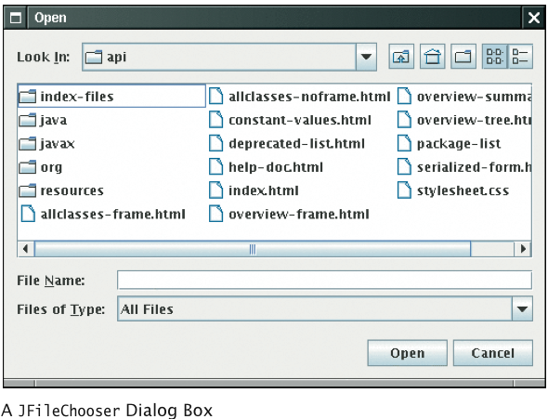
File Dialog Boxes
JFileChooser chooser = new JFileChooser();
FileReader in = null;
if (chooser.showOpenDialog(null) ==
JFileChooser.APPROVE_OPTION)
{
File selectedFile = chooser.getSelectedFile();
reader = new FileReader(selectedFile);
...
}
Big Java by Cay Horstmann
Copyright © 2009 by John Wiley & Sons. All rights reserved.

Slide 21
Reading Text Input: Reading Words
The next method reads a word at a time:
  while (in.hasNext())
  {
  String input = in.next();
  System.out.println(input);
  }
With our sample input, the output is:
  Mary
  had
  a
  little
  lamb
  …
A word is any sequence of characters that is not white space
Big Java by Cay Horstmann
Copyright © 2009 by John Wiley & Sons. All rights reserved.

Slide 22
Reading Text Input: Reading Words
To specify a pattern for word boundaries, call
  Scanner.useDelimiter
Example: discard anything that isn't a letter:
  Scanner in = new Scanner(. . .);
  in.useDelimiter("[^A-Za-z]+");
  ...
The notation used for describing the character pattern is called a regular expression
Big Java by Cay Horstmann
Copyright © 2009 by John Wiley & Sons. All rights reserved.

Slide 23
Reading Text Input: Processing Lines
The nextLine method reads a line of input and consumes the newline character at the end of the line:
  String line = in.nextLine();
Example: process a file with population data from the CIA Fact Book with lines like this:
  China 1330044605
  India 1147995898
  United States 303824646
  ...
First read each input line into a string
Big Java by Cay Horstmann
Copyright © 2009 by John Wiley & Sons. All rights reserved.

Slide 24
Reading Text Input: Processing Lines
Then use the isDigit and isWhitespace methods to find out where the name ends and the number starts. E.g. locate the first digit:
  int i = 0;
  while (!Character.isDigit(line.charAt(i))) { i++; }
Then extract the country name and population:
  String countryName = line.substring(0, i);
  String population = line.substring(i);
Big Java by Cay Horstmann
Copyright © 2009 by John Wiley & Sons. All rights reserved.

Slide 25
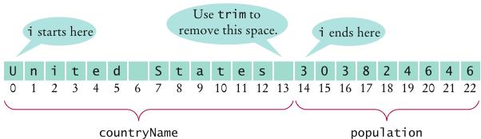
Reading Text Input: Processing Lines
Use the trim method to remove spaces at the end of the country name:
  countryName = countryName.trim();
To convert the population string to a number, first trim it, then call the Integer.parseInt method:
  int populationValue =
  Integer.parseInt(population.trim());
Big Java by Cay Horstmann
Copyright © 2009 by John Wiley & Sons. All rights reserved.

Slide 26
Reading Text Input: Processing Lines
Occasionally easier to construct a new Scanner object to read the characters from a string:
  Scanner lineScanner = new Scanner(line);
Then you can use lineScanner like any other Scanner object, reading words and numbers:
  String countryName = lineScanner.next();
  while (!lineScanner.hasNextInt())
  {
  countryName = countryName + " " + lineScanner.next();
  }
  int populationValue = lineScanner.nextInt();
Big Java by Cay Horstmann
Copyright © 2009 by John Wiley & Sons. All rights reserved.

Slide 27
Reading Text Input: Reading Numbers
nextInt and nextDouble methods consume white space and the next number:
  double value = in.nextDouble();
If there is no number in the input, then a InputMismatchException occurs; e.g.
To avoid exceptions, use the hasNextDouble and hasNextInt methods to screen the input:
  if (in.hasNextDouble())
  {
  double value = in.nextDouble();
  . . .
  }
Big Java by Cay Horstmann
Copyright © 2009 by John Wiley & Sons. All rights reserved.

Slide 28
Reading Text Input: Reading Numbers
nextInt and nextDouble methods do not consume the white space that follows a number
Example: file contains student IDs and names in this format:
  1729
  Harry Morgan
  1730
  Diana Lin
  . . .
Read the file with these instructions:
  while (in.hasNextInt())
  {
  int studentID = in.nextInt();
  String name = in.nextLine();
  Process the student ID and name
  }
Big Java by Cay Horstmann
Copyright © 2009 by John Wiley & Sons. All rights reserved.

Slide 29
Reading Text Input: Reading Numbers
Initially, the input contains
After the first call to nextInt, the input contains
The call to nextLine reads an empty string! The remedy is to add a call to nextLine after reading the ID:
  int studentID = in.nextInt();
  in.nextLine(); // Consume the newline
  String name = in.nextLine();
Big Java by Cay Horstmann
Copyright © 2009 by John Wiley & Sons. All rights reserved.

Slide 30
Reading Text Input: Reading Characters
To read one character at a time, set the delimiter pattern to the empty string:
  Scanner in = new Scanner(. . .);
  in.useDelimiter("");
Now each call to next returns a string consisting of a single character
To process the characters:
  while (in.hasNext())
  {
  char ch = in.next().charAt(0);
  Process ch
  }
Big Java by Cay Horstmann
Copyright © 2009 by John Wiley & Sons. All rights reserved.

Slide 31
Throwing Exceptions
Throw an exception object to signal an exceptional condition
Example: IllegalArgumentException: Illegal parameter value:
IllegalArgumentException exception
= new IllegalArgumentException("Amount exceeds
balance");
throw exception;
No need to store exception object in a variable:
throw new IllegalArgumentException("Amount exceeds
balance");
When an exception is thrown, method terminates immediately
  Execution continues with an exception handler
Big Java by Cay Horstmann
Copyright © 2009 by John Wiley & Sons. All rights reserved.

Slide 32
Example
public class BankAccount
{
public void withdraw(double amount)
{
if (amount > balance)
{
IllegalArgumentException exception
= new IllegalArgumentException("Amount
exceeds balance");
throw exception;
}
balance = balance - amount;
}
...
}
Big Java by Cay Horstmann
Copyright © 2009 by John Wiley & Sons. All rights reserved.

Slide 33
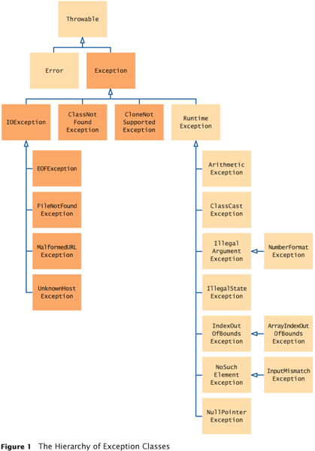
Hierarchy of Exception Classes
Big Java by Cay Horstmann
Copyright © 2009 by John Wiley & Sons. All rights reserved.

Slide 34
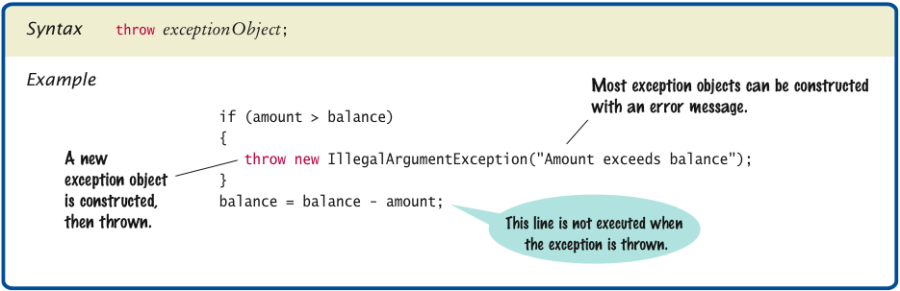
Syntax 11.1 Throwing an Exception
Big Java by Cay Horstmann
Copyright © 2009 by John Wiley & Sons. All rights reserved.

Slide 35
Checked and Unchecked Exceptions
Two types of exceptions:
  Checked
    The compiler checks that you don’t ignore them
    Due to external circumstances that the programmer cannot prevent
    Majority occur when dealing with input and output
    For example, IOException
  Unchecked
    Extend the class RuntimeException or Error
    They are the programmer’s fault
    Examples of runtime exceptions:
    NumberFormatException
    IllegalArgumentException
    NullPointerException
    Example of error:
    OutOfMemoryError
Big Java by Cay Horstmann
Copyright © 2009 by John Wiley & Sons. All rights reserved.

Slide 36
Checked and Unchecked Exceptions
Categories aren’t perfect:
  Scanner.nextInt throws unchecked InputMismatchException
  Programmer cannot prevent users from entering incorrect input
  This choice makes the class easy to use for beginning programmers
Deal with checked exceptions principally when programming with files and streams
For example, use a Scanner to read a file:
  String filename = ...;
  FileReader reader = new FileReader(filename);
  Scanner in = new Scanner(reader);
But, FileReader constructor can throw a FileNotFoundE`xception
Big Java by Cay Horstmann
Copyright © 2009 by John Wiley & Sons. All rights reserved.

Slide 37
Checked and Unchecked Exceptions
Two choices:
  Handle the exception
  Tell compiler that you want method to be terminated when the exception occurs
    Use throws specifier so method can throw a checked exception
    public void read(String filename) throws
    FileNotFoundException
    {
    FileReader reader = new FileReader(filename);
    Scanner in = new Scanner(reader);
    ...
    }
    For multiple exceptions:
    public void read(String filename)
    throws IOException, ClassNotFoundException
Continued
Big Java by Cay Horstmann
Copyright © 2009 by John Wiley & Sons. All rights reserved.

Slide 38
Checked and Unchecked Exceptions (cont.)
    Keep in mind inheritance hierarchy: If method can throw an IOException and FileNotFoundException, only use IOException
Better to declare exception than to handle it incompetently
Big Java by Cay Horstmann
Copyright © 2009 by John Wiley & Sons. All rights reserved.

Slide 39
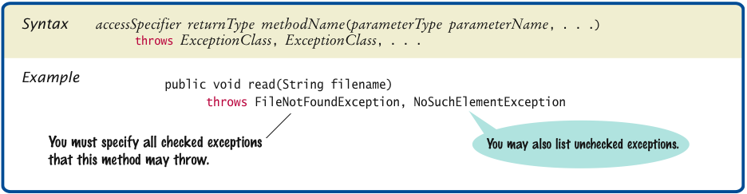
Syntax 11.2 throws Clause
Big Java by Cay Horstmann
Copyright © 2009 by John Wiley & Sons. All rights reserved.

Slide 40
Catching Exceptions
Install an exception handler with try/catch statement
try block contains statements that may cause an exception
catch clause contains handler for an exception type
Continued
Big Java by Cay Horstmann
Copyright © 2009 by John Wiley & Sons. All rights reserved.

Slide 41
Catching Exceptions
Example:
try
{
String filename = ...;
FileReader reader = new FileReader(filename);
Scanner in = new Scanner(reader);
String input = in.next();
int value = Integer.parseInt(input);
...
}
catch (IOException exception)
{
exception.printStackTrace();
}
catch (NumberFormatException exception)
{
System.out.println("Input was not a number");
}
Big Java by Cay Horstmann
Copyright © 2009 by John Wiley & Sons. All rights reserved.

Slide 42
Catching Exceptions
Statements in try block are executed
If no exceptions occur, catch clauses are skipped
If exception of matching type occurs, execution jumps to catch clause
If exception of another type occurs, it is thrown until it is caught by another try block
catch (IOException exception) block
  exception contains reference to the exception object that was thrown
  catch clause can analyze object to find out more details
  exception.printStackTrace(): Printout of chain of method calls that lead to exception
Big Java by Cay Horstmann
Copyright © 2009 by John Wiley & Sons. All rights reserved.

Slide 43
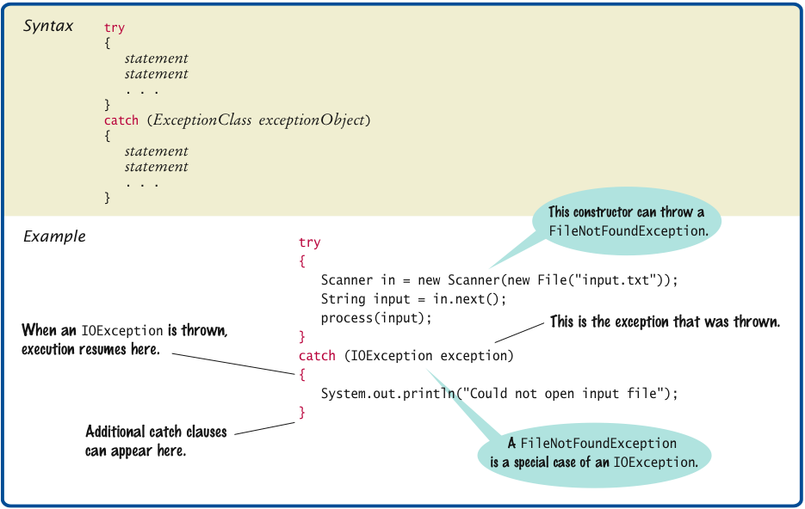
Syntax 11.3 Catching Exceptions
Big Java by Cay Horstmann
Copyright © 2009 by John Wiley & Sons. All rights reserved.

Slide 44
The finally Clause
Exception terminates current method
Danger: Can skip over essential code
Example:
  reader = new FileReader(filename);
  Scanner in = new Scanner(reader);
  readData(in);
  reader.close(); // May never get here
Must execute reader.close() even if exception happens
Use finally clause for code that must be executed “no matter what”
Big Java by Cay Horstmann
Copyright © 2009 by John Wiley & Sons. All rights reserved.

Slide 45
The finally Clause
FileReader reader = new FileReader(filename);
try
{
Scanner in = new Scanner(reader);
readData(in);
}
finally
{
reader.close();
// if an exception occurs, finally clause
// is also executed before exception
// is passed to its handler
}
Big Java by Cay Horstmann
Copyright © 2009 by John Wiley & Sons. All rights reserved.

Slide 46
The finally Clause
Executed when try block is exited in any of three ways:
  After last statement of try block
  After last statement of catch clause, if this try block caught an exception
  When an exception was thrown in try block and not caught
Recommendation: Don’t mix catch and finally clauses in same try block
Big Java by Cay Horstmann
Copyright © 2009 by John Wiley & Sons. All rights reserved.

Slide 47
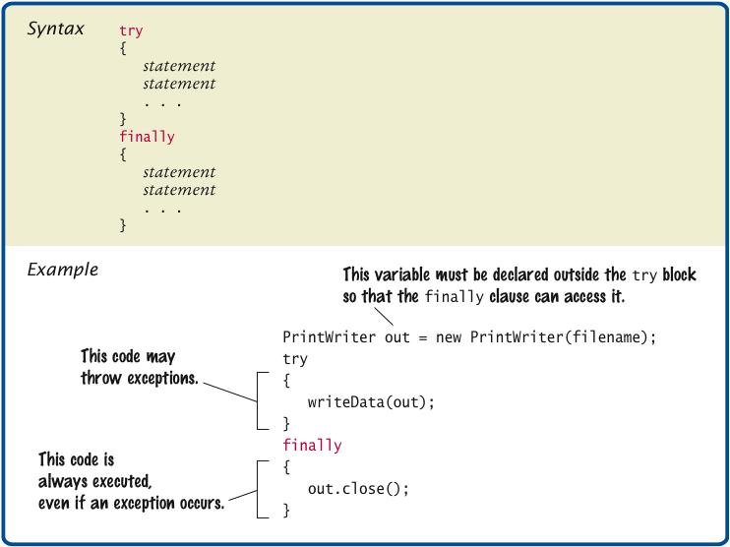
Syntax 11.4 finally Clause
Big Java by Cay Horstmann
Copyright © 2009 by John Wiley & Sons. All rights reserved.

Slide 48
Designing Your Own Exception Types
You can design your own exception types — subclasses of Exception or RuntimeException
if (amount > balance)
{
throw new InsufficientFundsException(
"withdrawal of " + amount + " exceeds balance of "
+ balance);
}
Make it an unchecked exception — programmer could have avoided it by calling getBalance first
Extend RuntimeException or one of its subclasses
Supply two constructors
  Default constructor
  A constructor that accepts a message string describing reason for exception
Big Java by Cay Horstmann
Copyright © 2009 by John Wiley & Sons. All rights reserved.

Slide 49
Designing Your Own Exception Types
public class InsufficientFundsException
extends RuntimeException
{
public InsufficientFundsException() {}
public InsufficientFundsException(String message)
{
super(message);
}
}
Big Java by Cay Horstmann
Copyright © 2009 by John Wiley & Sons. All rights reserved.

Slide 50
Case Study: A Complete Example
Program
  Asks user for name of file
  File expected to contain data values
  First line of file contains total number of values
  Remaining lines contain the data
  Typical input file:
  3
  1.45
  -2.1
  0.05
Big Java by Cay Horstmann
Copyright © 2009 by John Wiley & Sons. All rights reserved.

Slide 51
Case Study: A Complete Example
What can go wrong?
  File might not exist
  File might have data in wrong format
Who can detect the faults?
  FileReader constructor will throw an exception when file does not exist
  Methods that process input need to throw exception if they find error in data format
What exceptions can be thrown?
  FileNotFoundException can be thrown by FileReader constructor
  IOException can be thrown by close method of FileReader
  BadDataException, a custom checked exception class
Big Java by Cay Horstmann
Copyright © 2009 by John Wiley & Sons. All rights reserved.

Slide 52
Case Study: A Complete Example
Who can remedy the faults that the exceptions report?
  Only the main method of DataSetTester program interacts with user
  Catches exceptions
  Prints appropriate error messages
  Gives user another chance to enter a correct file
Big Java by Cay Horstmann
Copyright © 2009 by John Wiley & Sons. All rights reserved.

Slide 53
ch11/data/DataAnalyzer.java
1 import java.io.FileNotFoundException;
2 import java.io.IOException;
3 import java.util.Scanner;
4
5 /**
6 This program reads a file containing numbers and analyzes its contents.
7 If the file doesn&apos;t exist or contains strings that are not numbers, an
8 error message is displayed.
9 */
10 public class DataAnalyzer
11 {
12 public static void main(String[] args)
13 {
14 Scanner in = new Scanner(System.in);
15 DataSetReader reader = new DataSetReader();
16
17 boolean done = false;
18 while (!done)
19 {
Continued
Big Java by Cay Horstmann
Copyright © 2009 by John Wiley & Sons. All rights reserved.

Slide 54
ch11/data/DataAnalyzer.java (cont.)
20 try
21 {
22 System.out.println("Please enter the file name: ");
23 String filename = in.next();
24
25 double[] data = reader.readFile(filename);
26 double sum = 0;
27 for (double d : data) sum = sum + d;
28 System.out.println("The sum is " + sum);
29 done = true;
30 }
31 catch (FileNotFoundException exception)
32 {
33 System.out.println("File not found.");
34 }
35 catch (BadDataException exception)
36 {
37 System.out.println("Bad data: " + exception.getMessage());
38 }
39 catch (IOException exception)
40 {
41 exception.printStackTrace();
42 }
43 }
44 }
45 }
Big Java by Cay Horstmann
Copyright © 2009 by John Wiley & Sons. All rights reserved.

Slide 55
The readFile Method of the DataSetReader Class
Constructs Scanner object
Calls readData method
Completely unconcerned with any exceptions
Big Java by Cay Horstmann
Copyright © 2009 by John Wiley & Sons. All rights reserved.

Slide 56
The readFile Method of the DataSetReader Class
If there is a problem with input file, it simply passes the exception to caller:
  public double[] readFile(String filename)
  throws IOException, BadDataException
  // FileNotFoundException is an IOException
  {
  FileReader reader = new FileReader(filename);
  try
  {
  Scanner in = new Scanner(reader);
  readData(in);
  }
  finally
  {
  reader.close();
  }
  return data;
  }
Big Java by Cay Horstmann
Copyright © 2009 by John Wiley & Sons. All rights reserved.

Slide 57
The readFile Method of the DataSetReader Class
Reads the number of values
Constructs an array
Calls readValue for each data value:
private void readData(Scanner in) throws BadDataException
{
if (!in.hasNextInt())
throw new BadDataException("Length expected");
int numberOfValues = in.nextInt();
data = new double[numberOfValues];
for (int i = 0; i < numberOfValues; i++)
readValue(in, i);
if (in.hasNext())
throw new BadDataException("End of file expected");
}
Big Java by Cay Horstmann
Copyright © 2009 by John Wiley & Sons. All rights reserved.

Slide 58
The readFile Method of the DataSetReader Class
Checks for two potential errors
  File might not start with an integer
  File might have additional data after reading all values
Makes no attempt to catch any exceptions
private void readValue(Scanner in, int i) throws
BadDataException
{
if (!in.hasNextDouble())
throw new BadDataException("Data value expected");
data[i] = in.nextDouble();
}
Big Java by Cay Horstmann
Copyright © 2009 by John Wiley & Sons. All rights reserved.

Slide 59
Scenario
DataSetTester.main calls DataSetReader.readFile
readFile calls readData
readData calls readValue
readValue doesn’t find expected value and throws
BadDataException
readValue has no handler for exception and terminates
readData has no handler for exception and terminates
readFile has no handler for exception and terminates after executing finally clause
DataSetTester.main has handler for BadDataException; handler prints a message, and user is given another chance to enter file name
Big Java by Cay Horstmann
Copyright © 2009 by John Wiley & Sons. All rights reserved.

Slide 60
ch11/data/DataSetReader.java
1 import java.io.File;
2 import java.io.IOException;
3 import java.util.Scanner;
4
5 /**
6 Reads a data set from a file. The file must have the format
7 numberOfValues
8 value1
9 value2
10 . . .
11 */
12 public class DataSetReader
13 {
14 private double[] data;
15
Continued
Big Java by Cay Horstmann
Copyright © 2009 by John Wiley & Sons. All rights reserved.

Slide 61
ch11/data/DataSetReader.java (cont.)
16 /**
17 Reads a data set.
18 @param filename the name of the file holding the data
19 @return the data in the file
20 */
21 public double[] readFile(String filename) throws IOException
22 {
23 File inFile = new File(filename);
24 Scanner in = new Scanner(inFile);
25 try
26 {
27 readData(in);
28 return data;
29 }
30 finally
31 {
32 in.close();
33 }
34 }
35
Continued
Big Java by Cay Horstmann
Copyright © 2009 by John Wiley & Sons. All rights reserved.

Slide 62
ch11/data/DataSetReader.java (cont.)
36 /**
37 Reads all data.
38 @param in the scanner that scans the data
39 */
40 private void readData(Scanner in) throws BadDataException
41 {
42 if (!in.hasNextInt())
43 throw new BadDataException("Length expected");
44 int numberOfValues = in.nextInt();
45 data = new double[numberOfValues];
46
47 for (int i = 0; i < numberOfValues; i++)
48 readValue(in, i);
49
50 if (in.hasNext())
51 throw new BadDataException("End of file expected");
52 }
53
Continued
Big Java by Cay Horstmann
Copyright © 2009 by John Wiley & Sons. All rights reserved.

Slide 63
ch11/data/DataSetReader.java (cont.)
54 /**
55 Reads one data value.
56 @param in the scanner that scans the data
57 @param i the position of the value to read
58 */
59 private void readValue(Scanner in, int i) throws BadDataException
60 {
61 if (!in.hasNextDouble())
62 throw new BadDataException("Data value expected");
63 data[i] = in.nextDouble();
64 }
65 }
Big Java by Cay Horstmann
Copyright © 2009 by John Wiley & Sons. All rights reserved.

Slide 64
ch11/data/BadDataException.java
1 import java.io.IOException;
2
3 /**
4 This class reports bad input data.
5 */
6 public class BadDataException extends IOException
7 {
8 public BadDataException() {}
9 public BadDataException(String message)
10 {
11 super(message);
12 }
13 }
Big Java by Cay Horstmann
Copyright © 2009 by John Wiley & Sons. All rights reserved.

